Slide 1
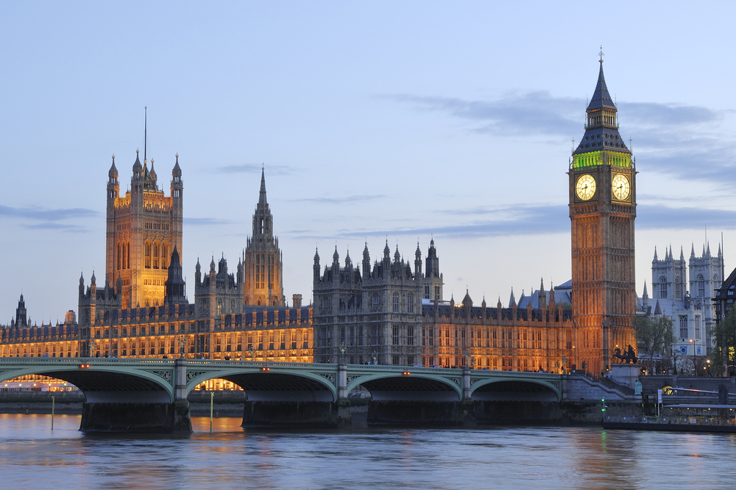
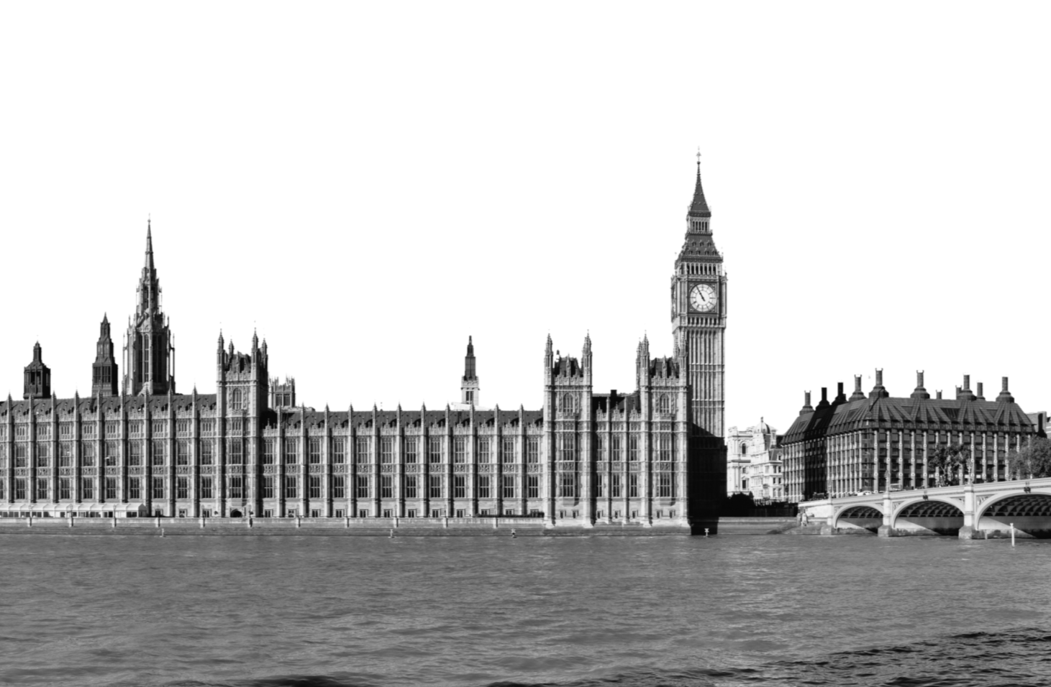
Ipsos MORI
Brexit: then and now
EEC 1975 – EU 2016
POLITICAL MONITOR
Sir Robert Worcester KBE DL
Visiting Professor, LSE & KCL
Founder, MORI
Institute of Commonwealth Studies, 24 May 2016

Slide 2
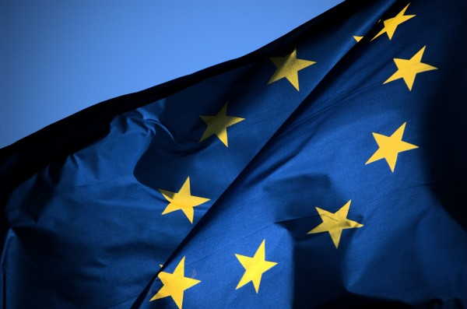
“There are three characteristics of the public’s attitudes to Britain’s membership of the EU – changeable, ignorant and half hearted” (1975)
Hugo Young, Political Editor, Sunday Times “This Blessed Plot”

Slide 3
The Times – Friday 22 April 2016
The Sunday Times – Sunday 8 May 2016
The Sunday Times – Sunday 8 May 2016
The Guardian – Monday 9 May 2016
The Financial Times – Monday 9 May 2016
The Times – Monday 9 May 2016
The Daily Telegraph – Monday 9 May 2016
The Daily Telegraph – Monday 9 May 2016
The Daily Telegraph – Tuesday 10 May 2016
The Times– Tuesday 10 May 2016
The Daily Telegraph – Friday 13 May 2016
USA Today – Thursday 12 May 2016

Slide 4
Setting the Scene : 5th May ‘75
Leadership: Harold & Jim
Negotiation: Harold & Helmut
Strategy: Harold
Tactics: Referendum Steering Group: Jim + 7 Cabinet Members
Team: Roy, Bernard, Tom, John Grant, Oliver Wright, Michael Butler, half a dozen others (& me)

Slide 5
State of Play: 5th – 22nd May ‘75
Public polls all in line: c. 67% to 33%
Private poll slightly higher: 70%/67% panel
Projected turnout: 74%
Mind made up: 85%
Targets: C2DE Women, 18-24, Scotland, TU
Front: Britain in Europe Campaign
Panel: 5th to 12th May, All NC: Con -5% swing, Labour +7% swing
14% undecided 22 May, women 2:1 DEs 2:1
Important to children’s future 2:1 agree

Slide 6
“In” Profiles: 22th May ’75 v. ‘16
Referendum | 1975 | 2016
All = 100% | 64% | 58%
Men = 46% now 49% | 68% | 58%
Women = 54%/51% | 58% | 58%
18-34 = 33%/29% | 58% | 73%
35 - 54 = 31%/35% | 65% | 60%
55+ = 36%/36% | 66% | 44%
ABC1 = 42%/54% | 79% | 67%
C2 = 32%/22% | 59% | 47%
DE = 26%/24% | 49% | 46%
Conservative = 40% /28% | 80% | 61%
Labour = 34%/31% | 50% | 76%
Liberal/Other = 16%/16% | 70% | 45%
North/Scotland = 33% '16 |  | 57%
Midlands/Wales = 31% '16 |  | 49%
South = 36% '16% |  | 67%
Source: 1975: Tracking polls and panel for RSG; Source: 2016: Ipsos MORI survey

Slide 7
“In” Profiles: 22th May ’75 v. ‘16
Base: 1,002 adults 18+ by telephone, 14-16 May 2016, wtd.

Slide 8
Issues : 12th May ‘75
Q. “…What do you think most people will think about when they decide how they will vote?”
Top mentions %
45% 17 May
72% 20 May
7% 17 May
14% 20 May
9% 27 May
Others

Slide 9
Issues Facing Britain: March
Q. “What do you see as the most/other important issues facing Britain today?”
Top mentions %
Change since Feb:
%
Position
+2
-4
+2
+3
0
+1
-2
-1
+1
+2
-1
-1
-1
-1
0
+2

Slide 10
Issues Facing Britain: April
Q. “What do you see as the most/other important issues facing Britain today?”
Top mentions %
Change since March:
%
Position
-5
+5
+7
+1
-3
-1
+2
+3
+2
+2
+3
+1
+1
-3
+3
+2
Source: Ipsos MORI Issues Index

Slide 11
Issues Facing Britain:
Common Market / Europe / Euro / EU
Q. “What do you see as the most/other important issues facing Britain today?”
Between 2005 and 2015 on average 5% said EU was important issue
Cameron becomes PM
Treaty of Accession: 10 new EU Member States
Highest score since June 2003 (23%)
France and Holland reject ratification of EU constitution
UKIP come first in European Parliament elections
Lowest score recorded (1%)
Base: representative sample of c.1,000 British adults age 18+ each month, interviewed face-to-face ,in home
Source: Ipsos MORI Issues Index

Slide 12
More Tories, Rural, Middle Class rate EU important
Q. “What do you see as the most/other important issues facing Britain today?”
EU/Europe, by key demographic groups:
Concern by region:
30%
18%
23%
16%
16%
Overall
Urban
Rural
CON
LAB
AB
C1
C2
DE
24%
Locale
Party support
Social Grade
Concern about EU/Europe by age group:
19%
32%
36%
18%
24%
27%
12%
14%
18-24
25-34
35-44
45-54
55-64
65+

Slide 13
Should Britain vote to leave the European Union?
Trend since 1977
Q. “If there were a referendum now on whether Britain should stay in or get out of the European Union, how would you vote?”
Stay in | Get out
Source: Ipsos MORI Political Monitor

Slide 14
Benefits of the EU?
Travel means more to young, Economy more to older
Q. “What does the EU mean to you personally?”
EU 27
GB
Base: 985 British adults 18+, 26th February – 23rd March 2016 Source: Ipsos MORI Issues Index

Slide 15
Britain’s future role in Europe
Q. “Which of the options best describes your own preference for Britain’s future role in Europe?”
Britain and other member states of the European Union moving towards closer political and economic integration
Oct‘15
Jun ‘15
Oct ‘14
May ‘14
Nov ‘12
Apr ‘96
Oct‘15
Britain’s relationship with Europe remaining broadly the same as at present
Jun ‘15
Oct ‘14
May ‘14
Nov ‘12
Apr ‘96
Oct‘15
Britain returning to being part on economic community, without political links
Jun ‘15
Oct ‘14
May ‘14
Nov ‘12
Apr ‘96
Oct‘15
Britain leaving the European Union altogether
Jun ‘15
Oct ‘14
May ‘14
Nov ‘12
Apr ‘96
Source: Ipsos MORI Political Monitor

Slide 16

European Referendum voting intention
Q. “As you may know the United Kingdom will have a referendum on its membership of the European Union on the 23rd of June this year. How will you vote on the question – “Should the United Kingdom remain a member of the European Union or leave the European Union? How would you be inclined to vote”?”
Qa/b) all giving a voting intention
Qa/b combined) all 9/10 and always/usually vote
Remain
Leave
Undecided
Would not vote
Refused
Base: 1,023 British adults 18+, 19th – 22nd March 2016
Source: Ipsos MORI Political Monitor

Slide 17
Who is voting to remain/leave the EU (Brexit)?
Q. “As you may know the United Kingdom will have a referendum on its membership of the European Union on the 23rd of June this year. How will you vote on the question – “Should the United Kingdom remain a member of the European Union or leave the European Union? How would you be inclined to vote?”
Source: Ipsos MORI Political Monitor

Slide 18
Who says they are ‘absolutely certain to vote?
And how much does their vote count?
In effect, a 65+ voter has nearly FIVE times the weight of the 18-24 year olds, as there are three times as many of them and they are half again more likely to vote
8%
(51% of 18-24s say they are absolutely certain to vote)
42%
(66% of 25-44s say they are absolutely certain to vote)
27%
(75% of 45-64s say they are absolutely certain to vote)
24%
(70% of 65+s say they are absolutely certain to vote)
Source: Ipsos MORI

Slide 19
And who are the ‘don’t knows’? Remember, most peope who say they ‘don’t know’ don’t vote. Otherwise, the turnout would be over 80%!
Why don’t journalists seem to know this?
8%
(6% of 18-24s say they are undecided)
42%
(13% of 25-44s say they are undecided)
27%
(14% of 45-64s say they are undecided)
24%
(15% of 65+s say they are undecided)
Source: Ipsos MORI

Slide 20
Although few doubts among Captains of Industry
Q. “As you may know, the government has pledged to hold a referendum on the
United Kingdom’s membership of the European Union by 2017”…
Q “And if there were a referendum now on whether Britain should stay in or leave the European Union, how would you vote? “
Q. “Which outcome of the referendum do you think would be best for your business? “
Q “And which outcome would you personally prefer?”
Uk staying in/Stay in | Uk leaving/Get out | Don’t know | refused
Base: British Captains of Industry (102) Interviewed Sept – Dec 2015
Source: Ipsos MORI

Slide 21

Predicted outcome
Q. “Thinking ahead to the referendum on European Union membership, which of the following outcomes do you think is most likely?”
Remain supporters
Leave supporters
Britain will vote to remain a member of the European Union | Britain will vote to leave the European Union | Don’t know
Source: Ipsos MORI Political Monitor

Slide 22
Who wants a referendum on the EU and would vote “OUT”?
Q. “Do you think your own country should or should not hold a referendum on its European
Union membership?”
Q. “How would you vote if your country held such a referendum now?”
Think their own country should hold a referendum on EU membership
Would vote "out" if a referendum on their country's EU membership was held now
Base: 6017 adults aged 16-64 across Belgium, France, Germany, Hungary, Italy, Poland, Spain, Sweden, March-April 2016
Source: Ipsos Global @dvisor

Slide 23
Impact of Brexit on future EU
Q. “To what extent do you agree or disagree with the following statement?
If Britain left the European Union, other countries would follow?”
European Union countries
Countries outside of the European Union
agree
NEITHER AGREE NOR DISAGREE
disagree
Base: 11030 adults aged 16-64 across Australia, Belgium, Canada, France, Germany, Great Britain, Hungary, India, Italy, Poland, South Africa, Spain, Sweden, United States, March-April 2016
Source: Ipsos Global @dvisor

Slide 24
Impact of Brexit on future EU
Q. “To what extent do you agree or disagree with the following statement?
If Britain left the European Union, other countries would follow?”
European Union countries
% Strongly AGREE
% Tend to agree
% Neither agree nor disagree
% Tend to disagree
% Strongly AGREE
Countries outside of the European Union
Base: 11030 adults aged 16-64 across Australia, Belgium, Canada, France, Germany, Great Britain, Hungary, India, Italy, Poland, South Africa, Spain, Sweden, United States, March-April 2016
Source: Ipsos Global @dvisor

Slide 25
Have the EU referendum voters decided yet?
Q. “Have you definitely decided to vote for Britain to remain/leave the European Union or is there a chance you may change your mind before you vote?
DEFINITELY DECIDED | MAY CHANGE MIND | DON’T KNOW
Base: All expressing an opinion on how they will vote 928 British adults 18+, 19th – 22nd March 2016
Source: Ipsos MORI Political Monitor

Slide 26
Have the public definitely decided yet?
Q. “Have you definitely decided to vote for Britain to remain/leave the European Union or is there a chance you may change your mind before you vote?
Source: Ipsos MORI Political Monitor

Slide 27
Have the public definitely decided yet?
Q. “Have you definitely decided to vote for Britain to remain/leave the European Union or is there a chance you may change your mind before you vote?
Source: Ipsos MORI Political Monitor

Slide 28
Own view? (2015)
Q. “Which of the following best describes your own view of Britain remaining a member of the European Union?”
I strongly support Britain remaining a member of the European Union
I am generally in favour of Britain remaining a member of the European Union, but could be persuaded to leave if I thought it would be bad for Britain
I am generally opposed to Britain remaining a member of the European Union, but could be persuaded to remain if I thought it would be good for Britain
I strongly oppose Britain remaining a member of the European Union
Don't know
Source: Ipsos MORI Political Monitor

Slide 29
Importance of individuals in deciding how to vote
Who of the following, if any, will be important to you in deciding how to vote in the referendum on European Union membership? Please choose all that apply
February 2016
Source: Ipsos MORI Political Monitor

Slide 30
Most trusted sources of information about the EU referendum
Q. “Which two or three, if any, of the following sources do you trust most to give you the information you need to make your mind up how to vote in the European referendum?”
Will vote for GB TO stay in EU
Will vote for GB TO Leave EU
Source: Ipsos MORI

Slide 31
Sky high ratings for Obama in Britain, but most say ‘inappropriate to speak out’.
“Do you think Barack Obama has done a good or bad job as President of the United States?”
Q. “Is it appropriate for Obama to express a preference for how Britain should vote in the EU referendum?”
DK
Appropriate
Bad
Good
Inappropriate
Base: 22 April 2016
Source: YouGov

Slide 32
Brexit weakens the special relationship?
Q. “If Britain leaves the European Union, do you think it would make the special relationship between the United States and Britain stronger, weaker, or make no difference?”
Stronger
Weaker
No difference
Base: 1,005 online adults aged 16-64 in each of Great Britain and the United States, March 25 – April 8 2016
Source: Ipsos Global @dvisor

Slide 33
Should Britain vote to leave the European Union?
Q. “Should the United Kingdom remain a member of the European Union or leave the European Union? How would you be inclined to vote?”
POLLING AGENCY | END FW | REMAIN | LEAVE | LEAD |  | REMAIN | LEAVE | LEAD
Opinion | 19/05 | 44 | 40 | 16 |  | 52 | 48 | 5
YouGov | 1705 | 44 | 40 | 16 |  | 52 | 48 | 5
ComRes/DM | 17/05 | 51 | 41 | 8 |  | 55 | 45 | 11
Ipsos MORI | 16/05 | 48 | 35 | 17 |  | 58 | 42 | 16
ICM (P) | 15/03 | 47 | 39 | 14 |  | 55 | 45 | 9
ICM | 15/03 | 43 | 47 | 10 |  | 48 | 52 | -4
ICM | 08/05 | 44 | 46 | 10 |  | 49 | 51 | -2
*

Slide 34
What do the bookies know that we don’t? (4 May)
Stay | Probability | Remain | Leave | Probability
Bet365 | 4/11 | 73% | 27% | 11/5 |  | www.Bet365.com
888Sport | 3/10 | 77% | 23% | 23/10 |  | www.888Sport.com
Ladbrokes | 1/3 | 75% | 25% | 9/4 |  | www.ladbrokes.com
BetFair | 1/3 | 75% | 25% | 9/4 |  | www.betfair.co.uk
Last updated: 4th May 2016 Source: Pollstation

Slide 35
What do the bookies know that we don’t? (16 May)
Stay | Probability | Remain | Leave | Probability
Bet365 | 2/7 | 78% | 22% | 5/2 |  | www.Bet365.com
888Sport | 5/18 | 78% | 22% | 16/5 |  | www.888Sport.com
Ladbrokes | 2/7 | 78% | 22% | 5/2 |  | www.ladbrokes.com
BetFair | 1/3 | 75% | 25% | 9/4 |  | www.betfair.co.uk
Last updated: 16th May 2016 Source: Pollstation

Slide 36
Is there a “special relationship”?
Q. “To what extent do you agree or disagree that ‘there is currently a special relationship between the United States and Britain’?”
52%
+45
7%
43%
+23
20%
Base: 1,005 online adults aged 16-64 in each of Great Britain and the United States, March 25 – April 8 2016

Slide 37
What reforms may have biggest impact on leave supporters?
Q. “I am going to read a list of areas in which Britain’s relationship with the European Union could change. For each one, can you please tell me whether it would make you more likely for Britain to leave the EU, or if it would hake no difference?”
% much/a little more likely to vote to remain in the EU
All
Britain opting out from an "ever closer union" with Europe
All
Leavers
Restricting access to benefits that EU migrants can claim when in or out of work
Returning more powers to the UK Parliament, such as deciding how many hours doctors can work.
Restricting the right to free movement of labour between EU countries for EU citizens, so that immigration from the EU can be curbed.
Preventing countries that use the Euro currency from imposing extra rules on the City of London
Source: Ipsos MORI

Slide 38
THANK YOU

Slide 39
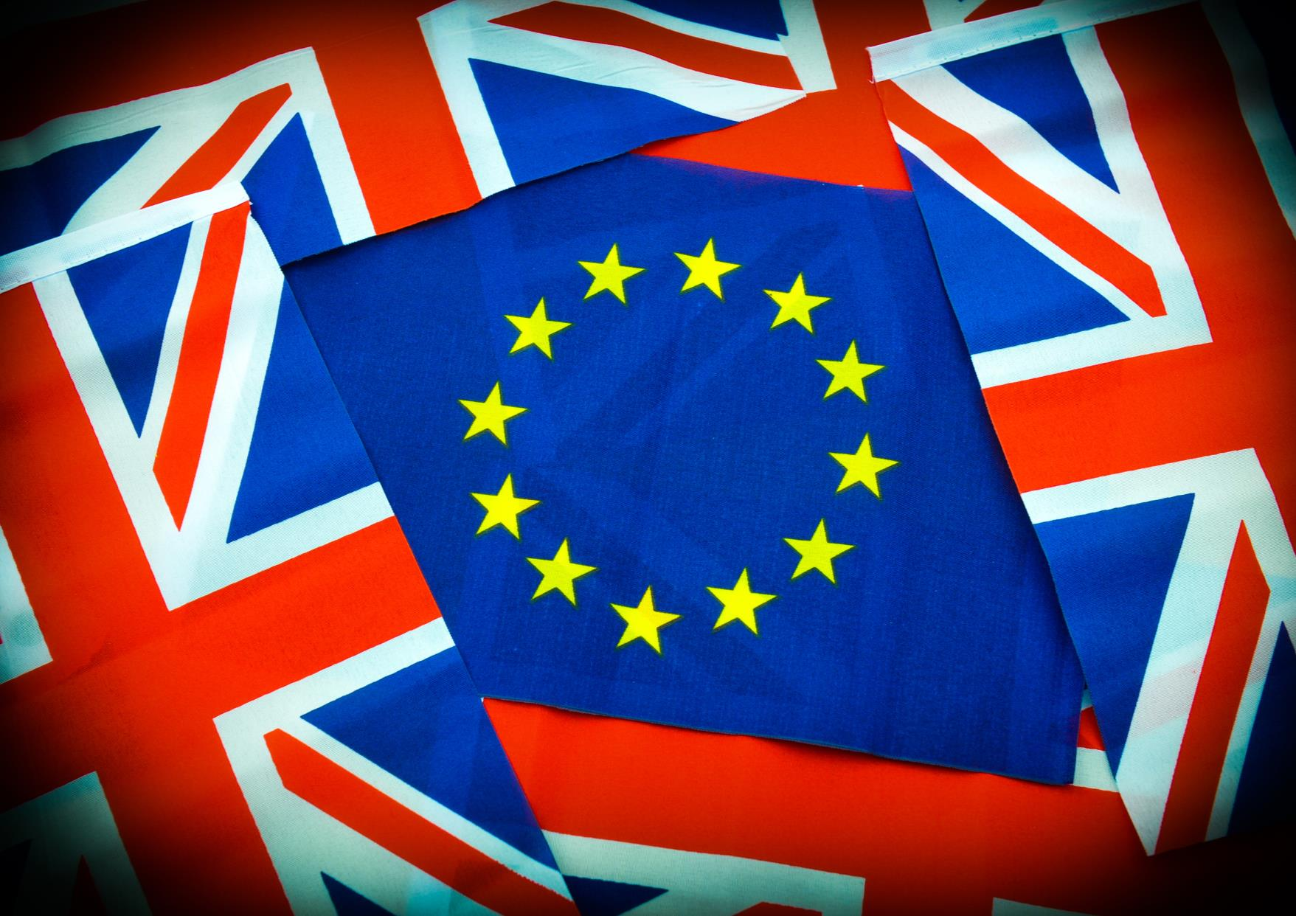
Ipsos Brexit poll
May 2016
Data released 9.5.16, 16 country survey carried out among 500-1,000 adults 16-64 by Ipsos Global @dvisor and published in the UK in the Financial Times.

Slide 40
Coverage
Referendum on EU
Impact of Brexit
Future of Europe

Slide 41
Methodology
These are the findings of the Brexit Survey. In total 11,030 interviews were conducted between March 25th – April 8th 2016 among adults aged 18-64 in the US and Canada, and adults aged 16-64 in all other countries.
The survey was conducted in 14 countries around the world via the Ipsos Online Panel system. The countries reporting herein are Australia, Belgium, Canada, France, Great Britain, Germany, Hungary, India, Italy, Poland, South Africa, Spain, Sweden, and the United States of America.
The nine European Union countries represent approximately three-quarters of the EU’s population and 80% of its GDP.
Approximately 1000+ individuals participated on a country by country basis via the Ipsos Online Panel with the exception of Belgium, Hungary, India, Poland, South Africa, and Sweden, where the sample was approximately 500+. The precision of Ipsos online polls is calculated using a credibility interval with a poll of 1,000 accurate to +/- 3.5 percentage points and of 500 accurate to +/- 5.0 percentage points. For more information on Ipsos’ use of credibility intervals, please visit the Ipsos website.
In countries where internet penetration is approximately 60% or higher the data output reflects the general population. Of the 14 countries surveyed online, 12 yield results that are balanced to reflect the general population: Australia, Belgium, Canada, France, Germany, Hungary, Italy, Poland, Spain, Sweden, United Kingdom and the United States. The two remaining countries surveyed - India (19%) and South Africa (47%) - have lower levels of internet connectivity and are therefore not reflective of the general population; however, the online sample in these countries are valuable in their own right as they are more urban/educated/income than their fellow citizens and are often referred to as “Upper Deck Consumer Citizens”.
Where results do not sum to 100, this may be due to computer rounding, multiple responses or the exclusion of don't knows or not stated responses. Data are weighted to match the profile of the population.

Slide 42
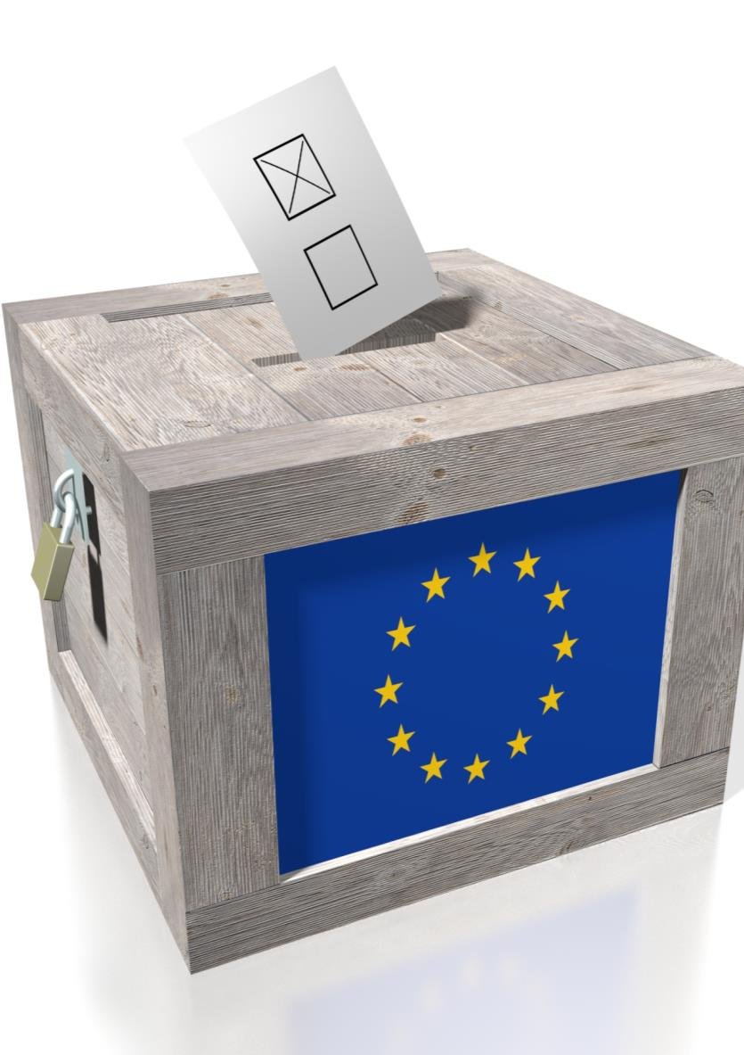
Referendum on the
EU

Slide 43
Will Britain stay in the EU or vote to leave?
Q “Thinking about Britain's referendum on European Union membership, which of the
following outcomes do you think is most likely?”
European Union countries
Countries outside of the European Union
Britain will vote to remain a member of the European Union
Britain will vote to leave the European Union
Base: 11,030 adults aged 16-64 across Australia, Belgium, Canada, France, Germany, Great Britain, Hungary, India, Italy, Poland, South Africa, Spain, Sweden, United States, March-April 2016
Source: Ipsos Global @dvisor

Slide 44
Will Britain stay in the EU or vote to leave?
Q. “Thinking about Britain's referendum on European Union membership, which of the
following outcomes do you think is most likely?”
European Union countries
% - Britain will vote to remain a member of the European Union
% - Britain will vote to leave the European Union
Countries outside of the European Union
Base: 11,030 adults aged 16-64 across Australia, Belgium, Canada, France, Germany, Great Britain, Hungary, India, Italy, Poland, South Africa, Spain, Sweden, United States, March-April 2016
Source: Ipsos Global @dvisor

Slide 45
Who wants a referendum on the EU and would vote “OUT”?
Q “Do you think your own country should or should not hold a referendum on its European
Union membership?“
Q. “How would you vote if your country held such a referendum now?”
45%
33%
Would vote "out" if a referendum on their country's EU membership was held now
Think their own country should hold a referendum on EU membership
Base: 6,017 adults aged 16-64 across Belgium, France, Germany, Hungary, Italy, Poland, Spain, Sweden, March-April 2016
Source: Ipsos Global @dvisor

Slide 46
Who wants a referendum on the EU and would vote “OUT”?
Q. “Do you think your own country should or should not hold a referendum on its European
Union membership?”
Q. “How would you vote if your country held such a referendum now?”
Think their own country should hold a referendum on EU membership
Would vote "out" if a referendum on their country's EU membership was held now
Base: 6017 adults aged 16-64 across Belgium, France, Germany, Hungary, Italy, Poland, Spain, Sweden, March-April 2016
Source: Ipsos Global @dvisor

Slide 47
Impact of Brexit on future EU
Q. “To what extent do you agree or disagree with the following statement?
If Britain left the European Union, other countries would follow?”
European Union countries
Countries outside of the European Union
agree
NEITHER AGREE NOR DISAGREE
disagree
Base: 11030 adults aged 16-64 across Australia, Belgium, Canada, France, Germany, Great Britain, Hungary, India, Italy, Poland, South Africa, Spain, Sweden, United States, March-April 2016
Source: Ipsos Global @dvisor

Slide 48
Impact of Brexit on future EU
Q. “To what extent do you agree or disagree with the following statement?
If Britain left the European Union, other countries would follow?”
European Union countries
% Strongly AGREE
% Tend to agree
% Neither agree nor disagree
% Tend to disagree
% Strongly AGREE
Countries outside of the European Union
Base: 11030 adults aged 16-64 across Australia, Belgium, Canada, France, Germany, Great Britain, Hungary, India, Italy, Poland, South Africa, Spain, Sweden, United States, March-April 2016
Source: Ipsos Global @dvisor

Slide 49
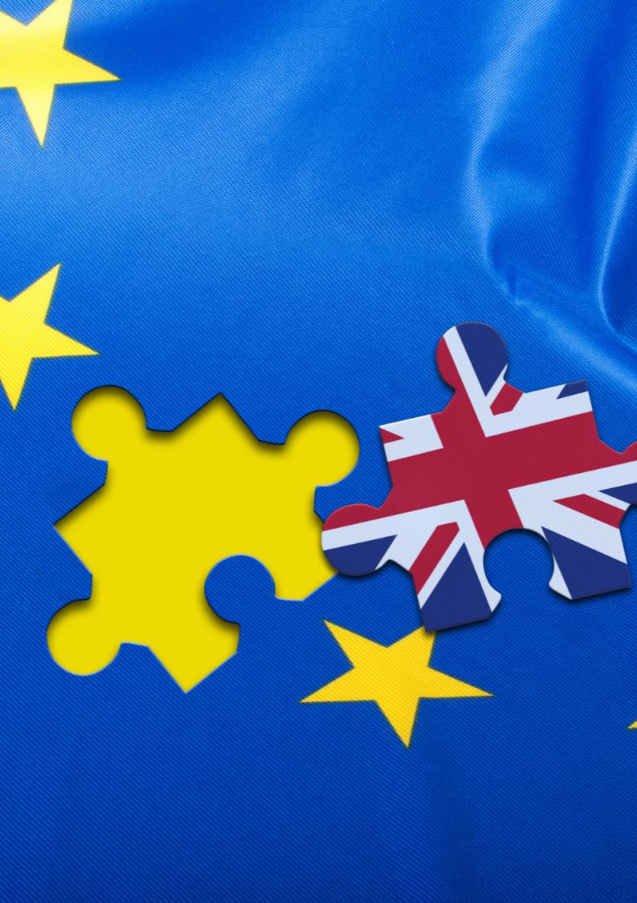
Impact of Brexit

Slide 50
The impact of Brexit on the British and EU economy
Q. “ If Britain did vote to leave the European Union, do you think it would have a positive
or negative impact, or make no difference, on…
the EU’s economy / Britain’s economy?”
European Union countries
Countries outside of the European Union
51%
41%
Think that Brexit would be somewhat to very negative for the EU's economy
36%
29%
Think that Brexit would be somewhat to very negative for Britain's economy
Base: 11030 adults aged 16-64 across Australia, Belgium, Canada, France, Germany, Great Britain, Hungary, India, Italy, Poland, South Africa, Spain, Sweden, United States, March-April 2016
Source: Ipsos Global @dvisor

Slide 51
The impact of Brexit on the British and EU economy
If Britain did vote to leave the European Union, do you think it would have a positive
or negative impact, or make no difference, on…
the EU’s economy / Britain’s economy?
% Think that Brexit would be somewhat to very negative for the EU's economy
% Think that Brexit would be somewhat to very negative for Britain's economy
European Union countries
Countries outside of the European Union
Base: 11030 adults aged 16-64 across Australia, Belgium, Canada, France, Germany, Great Britain, Hungary, India, Italy, Poland, South Africa, Spain, Sweden, United States, March-April 2016
Source: Ipsos Global @dvisor

Slide 52
The impact of Brexit on world politics
If Britain did vote to leave the European Union, do you think it would have a positive
or negative impact, or make no difference, on…
the EU’s influence on the world stage / Britain’s influence on the world stage?
European Union countries
Countries outside of the European Union
48%
34%
Think that Brexit would be somewhat to very negative for EU's influence on the world stage
38%
26%
Think that Brexit would be somewhat to very negative for Britain's influence on the world stage
Base: 11030 adults aged 16-64 across Australia, Belgium, Canada, France, Germany, Great Britain, Hungary, India, Italy, Poland, South Africa, Spain, Sweden, United States, March-April 2016
Source: Ipsos Global @dvisor

Slide 53
The impact of Brexit on world politics
If Britain did vote to leave the European Union, do you think it would have a positive
or negative impact, or make no difference, on…
the EU’s influence on the world stage / Britain’s influence on the world stage?
% Think that Brexit would be somewhat to very negative for EU's influence on the world stage
% Think that Brexit would be somewhat to very negative for Britain's influence on the world stage
European Union countries
Countries outside of the European Union
Base: 11030 adults aged 16-64 across Australia, Belgium, Canada, France, Germany, Great Britain, Hungary, India, Italy, Poland, South Africa, Spain, Sweden, United States, March-April 2016
Source: Ipsos Global @dvisor

Slide 54
Impact of Brexit on relationship with UK
If Britain leaves the European Union, do you think it would make the relationship
between your country and Britain stronger, weaker, or make no difference?
Stronger
Make no difference
weaker
European Union countries
Countries outside of the European Union
Base: 10025 adults aged 16-64 across Australia, Belgium, Canada, France, Germany, Hungary, India, Italy, Poland, South Africa, Spain, Sweden, United States, March-April 2016
Source: Ipsos Global @dvisor

Slide 55
Impact of Brexit on relationship with UK
If Britain leaves the European Union, do you think it would make the relationship
between your country and Britain stronger, weaker, or make no difference?
European Union countries
% Stronger
% Make no difference
% weaker
Countries outside of the European Union
Base: 10025 adults aged 16-64 across Australia, Belgium, Canada, France, Germany, Hungary, India, Italy, Poland, South Africa, Spain, Sweden, United States, March-April 2016
Source: Ipsos Global @dvisor

Slide 56

Future of Europe

Slide 57
How the future EU will and should look like
Do you think the European Union in 2020 will...
What should be the long-term policy of your country?
Base: 7022 adults aged 16-64 across Belgium, France, Germany, Great Britain , Hungary, Italy, Poland, Spain, Sweden, March-April 2016
Source: Ipsos Global @dvisor

Slide 58
How the future EU will and should look like
(1) Do you think the European Union in 2020 will... and
(2) What should be the long-term policy of your country…
What people think it will be (1)
What people want (2)
(1) ...have a single European government+ ...be more integrated, with more powers for the European Union compared to individual countries
(2) Work for the formation of a single European government + Stay in the EU and try to increase the EU's powers
(1) ...resemble todays European Union, with the same balance of powers between the EU and individual countries
(2) Leave things as they are
(1) ...be less integrated, with fewer powers for the European Union compared to individual countries + ...have disappeared altogether
(2) Stay in the EU and try to reduce the EU's powers + Leave the European Union
Base: 7022 adults aged 16-64 across Belgium, France, Germany, Great Britain , Hungary, Italy, Poland, Spain, Sweden, March-April 2016
Source: Ipsos Global @dvisor

Slide 59
How the future EU will and should look like
(1) Do you think the European Union in 2020 will... and
(2) What should be the long-term policy of your country…
% What people think it will be
% What people want
Belgium
Poland
Sweden
Hungary
France
Germany
Great Britain
Italy
Spain
Base: 7022 adults aged 16-64 across Belgium, France, Germany, Great Britain, Hungary, Italy, Poland, Spain, Sweden, March-April 2016
Source: Ipsos Global @dvisor

Slide 60
Views on future EU - outside Europe
Do you think the European Union in 2020 will...
…have a single European government+ be more integrated, with more powers for the European Union compared to individual countries
…resemble todays European Union, with the same balance of powers between the EU and individual countries
...be less integrated, with fewer powers for the European Union compared to individual countries + ...have disappeared altogether
Outer pie: Countries outside of the European Union
Inner pie: European Union countries
Base: 11030 adults aged 16-64 across Australia, Belgium, Canada, France, Germany, Great Britain, Hungary, India, Italy, Poland, South Africa, Spain, Sweden, United States, March-April 2016
Source: Ipsos Global @dvisor

Slide 61
For more information
Sir Robert Worcester KBE DL
Ipsos MORI UK
+44 (0)20 7347 3066
rmworcester@ipsos.com
Jean-Michel Lebrun
Research Director, Ipsos
+32 (0) 2 642 49 10
jean-michel.lebrun@ipsos.com
Daan Bijwaard
Research Executive, Ipsos
+32 (0) 2 642 49 37
daan.bijwaard@ipsos.com

Slide 62


APRIL 2016
Economist/ipsos mori issues index
Contacts:
Gideon.Skinner@ipsos.com
Michael.Clemence@ipsos.com
020 7347 3000

Slide 63
Issues Facing Britain: April
What do you see as the most/other important issues facing Britain today?
Top mentions %
Change since March:
%
Position
-5
+5
+7
+1
-3
-1
+2
+3
+2
+2
+3
+1
+1
-3
+3
+2
Source: Ipsos MORI Issues Index

Slide 64
Issues Facing Britain: April
What do you see as the most/other important issues facing Britain today?
Top mentions %
Most/Other important issues
MOST IMPORTANT ISSUE
Source: Ipsos MORI Issues Index

Slide 65
Issues Facing Britain: Long Term Trends
What do you see as the most/other important issues facing Britain today?
nhs
unemployment
CRIME/LAW & ORDER
ECONOMY
IMMIGRATION*
HOUSING
Source: Ipsos MORI Issues Index
*Up until September 2014 the code was race relations/immigration/immigrants

Slide 66
Issues Facing Britain:
Economy / Economic situation
What do you see as the most/other important issues facing Britain today?
Cameron becomes PM
Highest score since 1992; Most important issue for the first time
Global Recession and Russian Financial crisis
End of recession announced
Northern Rock nationalised
Lowest score since March 2008 (22%)
Sub-prime mortgage crisis in the US
Source: Ipsos MORI Issues Index

Slide 67
Issues Facing Britain:
Immigration / Immigrants*
What do you see as the most/other important issues facing Britain today?
Cameron becomes PM
Highest concern ever recorded (56%)
Border controls relaxed for “A8” EU Countries (Poland, etc.)
Border controls relaxed for Romanians and Bulgarians
Source: Ipsos MORI Issues Index

Slide 68
Issues Facing Britain:
Unemployment / Factory closure / Lack of industry
What do you see as the most/other important issues facing Britain today?
Cameron becomes PM
Youth unemployment reaches 1 million
Minimum wage introduced
Unemployment in Britain rises to 5.5%
Lowest score since October 2008 (14%)
Unemployment falls below 1 million for first time in 25 years
Lowest ever score
(5%)
Source: Ipsos MORI Issues Index

Slide 69
Issues Facing Britain:
Crime / Law & Order / Violence / Vandalism / ASB
What do you see as the most/other important issues facing Britain today?
Cameron becomes PM
May day riots
Riots in England
9/11
Lowest score since March 1991 (8%)
Source: Ipsos MORI Issues Index

Slide 70
Issues Facing Britain:
NHS / Hospitals / Healthcare
What do you see as the most/other important issues facing Britain today?
Report says waiting lists have doubled under Labour
Cameron becomes PM
Highest score since April 2006 (47%)
Lowest score since
December 1985 (12%)
Source: Ipsos MORI Issues Index

Slide 71
Issues Facing Britain:
Education / Schools
What do you see as the most/other important issues facing Britain today?
Introduction of means-tested tuition fees. Education most important issue.
Cameron becomes PM
Labour’s second term - pledge to improve failing secondary schools
First City Academies introduced
April 2011 – Pupil Premium introduced
Lowest score since Dec 1985 (9%)
Base: representative sample of c.1,000 British adults age 18+ each month, interviewed face-to-face in home
Source: Ipsos MORI Issues Index

Slide 72
Issues Facing Britain:
Defence / Foreign Affairs / International terrorism
What do you see as the most/other important issues facing Britain today?
Invasion of Iraq – protests across Europe
Cameron becomes PM
9/11
London Bombs
Paris attacks and Parliamentary vote for action against IS in Syria
Failed terror attacks in London and Glasgow
Parliamentary vote against action in Syria
War in Kosovo
NATO bombing in Libya
Rise of IS
UK withdraws from Iraq
Base: representative sample of c.1,000 British adults age 18+ each month, interviewed face-to-face in home
Source: Ipsos MORI Issues Index

Slide 73
Issues Facing Britain:
Poverty/inequality
What do you see as the most/other important issues facing Britain today?
Cameron becomes PM
Sept 1999:
Alastair Darling – “one child in three” living in poverty
July 2014:
highest score recorded (18%)
January 2005:
Make Poverty History campaign launched on New Year’s Day
Base: representative sample of c.1,000 British adults age 18+ each month, interviewed face-to-face in home
Source: Ipsos MORI Issues Index

Slide 74
Issues Facing Britain:
Inflation/Prices
What do you see as the most/other important issues facing Britain today?
Cameron becomes PM
Inflation rate hits 16 year peak
Inflation rises to 3.4%
Base: representative sample of c.1,000 British adults age 18+ each month, interviewed face-to-face in home
Source: Ipsos MORI Issues Index

Slide 75
Issues Facing Britain:
Housing
What do you see as the most/other important issues facing Britain today?
Cameron becomes PM
Highest score since October 1974 (21%)
“A8” Countries join the EU
Base: representative sample of c.1,000 British adults age 18+ each month, interviewed face-to-face in home
Source: Ipsos MORI Issues Index

Slide 76
Issues Facing Britain:
Pensions/Social Security/Benefits
What do you see as the most/other important issues facing Britain today?
Blair and Harriet Harman propose ‘affluence testing’ to exclude the well-off from state benefits
Cameron becomes PM
Gordon Brown unveils pension credits
Pensions commission report – “more than 12 million working people are not saving enough for their retirement”
Equitable Life sells its non-profit pension annuities
Lowest ever score (3%)
Base: representative sample of c.1,000 British adults age 18+ each month, interviewed face-to-face in home
Source: Ipsos MORI Issues Index

Slide 77
Issues Facing Britain:
Pollution / Environment
What do you see as the most/other important issues facing Britain today?
Cameron becomes PM
Wettest Autumn since records began – widespread flooding across the UK
EC proposes carbon emission cuts of 20% by 2020
Winter flooding and storms
Base: representative sample of c.1,000 British adults age 18+ each month, interviewed face-to-face in home
Source: Ipsos MORI Issues Index

Slide 78
Issues Facing Britain:
Common Market / Europe / Euro / EU
What do you see as the most/other important issues facing Britain today?
Cameron becomes PM
Highest score since
December 1999 (30%)
Treaty of Accession: 10 new EU Member States
France and Holland reject ratification of EU constitution
UKIP come first in European Parliament elections
Lowest score recorded (1%)
Base: representative sample of c.1,000 British adults age 18+ each month, interviewed face-to-face in home
Source: Ipsos MORI Issues Index

Slide 79
Issues Facing Britain:
Low pay/minimum wage/fair wages
What do you see as the most/other important issues facing Britain today?
Cameron becomes PM
Highest recorded score (15%)
Base: representative sample of c.1,000 British adults age 18+ each month, interviewed face-to-face in home
Source: Ipsos MORI Issues Index

Slide 80
Top issues – concern by party support
What do you see as the most/other important issues facing Britain today?
Top mentions %
Conservative supporters
Labour Supporters
Source: Ipsos MORI Issues Index

Slide 81
Age and social grade – different top issues amongst ABC1s
What do you see as the most/other important issues facing Britain today?
Top three issues by age and social grade
55+
Age bracket
35-54
18-34
ABC1
C2DE
Social grade
Base: 966 British adults 18+, 8th – 19th April 2016
Source: Ipsos MORI Issues Index

Slide 82
Issues facing Britain 2016: London
What do you see as the most/other important issues facing Britain today?
Top mentions %
London
Britain
Source: Ipsos MORI Issues Index

